Slide 1

HealthVerse AI: An Agentic Digital Healthcare Ecosystem for Predictive Health Monitoring and Personalized Wellness
SOA Project Review-1
Thursday, 20 August 2026
 | Under the Guidance of Dr. Srikanth Cherukuvada Assistant Professor, Department of Computer Science and Engineering, KLH CSE Bowrampet Campus
Team Members P. Pranathi - 2420030043 R.L.S. Giridhar - 2420030171 D. Krishna Chaitanya - 2420090077

Slide 2
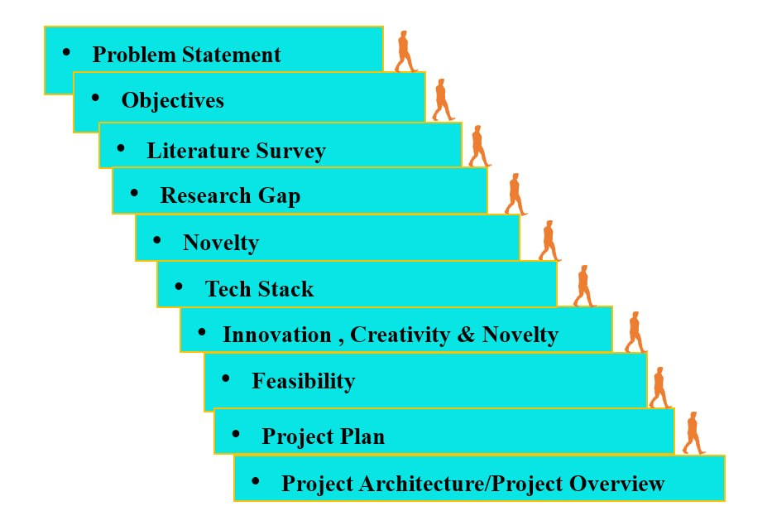
Outline of Research Work

Slide 3
Problem Statement
Current digital healthcare applications often provide separate services such as fitness tracking, symptom analysis, medication reminders, health monitoring, and basic health assistance, but they lack a unified and intelligent system for continuously analyzing diverse health and lifestyle parameters.
Health-related data is often distributed across multiple platforms, making it difficult to obtain a comprehensive view of an individual's health status and identify potential risks at an early stage. Furthermore, many existing systems offer generic recommendations that do not adequately consider a user's medical history, lifestyle habits, fitness activities, nutrition, sleep patterns, and wellness goals. Therefore, there is a need for an intelligent digital healthcare ecosystem that can integrate health data, continuously monitor health patterns, predict potential wellness risks, analyze medical reports, and provide personalized recommendations through Agentic AI-driven assistance and multi-agent collaboration.
Motivation
• To develop a proactive healthcare platform that goes beyond traditional health monitoring and promotes preventive healthcare.
• To enable early identification of potential health and wellness risks through predictive analytics and continuous health assessment.
• To provide personalized recommendations for nutrition, fitness, medication management, sleep improvement, and overall well-being.
• To utilize Agentic AI and multi-agent collaboration for intelligent health analysis, decision support, and personalized healthcare guidance.

Slide 4
Objectives
To develop an intelligent healthcare ecosystem that continuously monitors and analyzes user health data to support preventive healthcare and overall well-being.
To implement a multi-agent AI framework that enables specialized AI agents to collaborate in providing personalized health, nutrition, fitness, medication, and wellness recommendations.
To create a Digital Health Twin that maintains a dynamic and continuously evolving virtual representation of a user's health profile for personalized healthcare management.
To predict potential health and wellness risks using AI and data analytics based on health records, lifestyle patterns, medical reports, and historical health trends.
To analyze and simplify medical reports by providing easy-to-understand explanations and highlighting important health indicators for users.
To generate personalized wellness plans including diet recommendations, fitness schedules, hydration goals, medication reminders, and sleep improvement suggestions.
To provide explainable AI recommendations by presenting the reasoning, contributing factors, and confidence levels behind health insights and wellness suggestions.
To design a scalable microservices-based architecture that supports secure, efficient, and seamless integration of healthcare services, AI agents, and health data management systems.

Slide 5
Literature Survey
Authors | Title of the Paper | Methodology | Inferences | Limitation / Future Work
Meskó et al. [1] | AI Agent in Healthcare: Applications, Evaluations, and Future Directions, npj Artificial Intelligence, 2026 | • AI agents for healthcare decision support • Multi-agent healthcare workflows • Large Language Models (LLMs) • Clinical reasoning and patient assistance • AI evaluation and safety mechanisms | • Demonstrates the potential of AI agents in healthcare assistance • Shows how specialized agents can collaborate to improve decision-making • Highlights the importance of explainability and trust in healthcare AI | • Focuses mainly on healthcare AI agents rather than personalized wellness ecosystems • Does not implement a Digital Health Twin • Limited integration with predictive wellness planning • Our project combines multi-agent collaboration with predictive monitoring and personalized wellness generation
Coronato et al. [2] | Human Digital Twins in Personalized and Predictive Healthcare, Frontiers in Digital Health, 2026 | • Digital Twin architecture • Real-time health monitoring • Wearable device integration • AI-based health prediction • Personalized healthcare modeling | • Demonstrates how Digital Twins can continuously model user health status • Enables predictive healthcare and personalized recommendations • Supports proactive healthcare management | • Primarily focuses on Digital Twin concepts and predictive healthcare • Does not utilize multi-agent AI collaboration • Limited focus on wellness planning and report analysis • Our project extends the Digital Twin with Agentic AI and wellness planning capabilities
Wang et al. [3] | A Comprehensive Survey of AI Agents in Healthcare, Journal of Biomedical Informatics, 2026 | • Survey of healthcare AI agents • Multi-agent collaboration frameworks • Autonomous planning and reasoning • Tool integration and memory systems • Healthcare workflow automation | • Provides a comprehensive overview of AI agent architectures in healthcare • Highlights benefits of specialized AI agents working together • Identifies opportunities for autonomous healthcare assistance | • Survey paper without a complete implementation framework • Does not include Digital Health Twin technology • Limited focus on predictive wellness and personalized health planning • Our project integrates multi-agent collaboration, predictive analytics, Digital Twin technology, and explainable AI into a unified ecosystem

Slide 6
Research Gap Identification
Existing Research / Approach | Research Gap Identified | Our Proposed Solution
1. AI-Based Health Monitoring and Prediction – Existing healthcare systems use AI and Machine Learning models to monitor health parameters, predict diseases, and provide health insights based on historical medical data and wearable sensor information. | Most systems focus primarily on disease prediction or health monitoring as independent functionalities. They lack continuous personalization and do not maintain a comprehensive evolving health profile that adapts to user behavior, lifestyle, and health trends over time. | Digital Health Twin – HealthVerse AI maintains a continuously evolving virtual health profile that learns from health records, reports, lifestyle patterns, sleep, fitness, nutrition, and wellness data to provide personalized and adaptive healthcare recommendations.
2. Single-Agent Healthcare Chatbots and Decision Systems – Many existing healthcare applications use a single AI chatbot or decision-support model to answer health-related queries and provide recommendations. | Single-agent systems often have limited specialization and reasoning capabilities. They do not support collaborative decision-making among multiple healthcare domains such as nutrition, fitness, medication, wellness, and report analysis. | Multi-Agent Healthcare Collaboration System – HealthVerse AI employs specialized agents including Health Agent, Nutrition Agent, Fitness Agent, Medicine Agent, Wellness Agent, and Report Agent coordinated by a Planning Agent to generate comprehensive and personalized wellness recommendations.
3. Static Health Recommendations and Generic Wellness Plans – Existing health applications generally provide predefined wellness advice, fitness plans, or diet recommendations based on basic user information. | Recommendations are often generic and reactive rather than predictive. Most systems do not analyze long-term health trends, risk progression, or future wellness indicators to support preventive healthcare. | Predictive Wellness Engine – HealthVerse AI analyzes historical health data, lifestyle patterns, activity levels, sleep quality, and medical reports to identify future wellness risks and generate proactive, personalized wellness plans aimed at preventive healthcare.

Slide 7
Novelty
Novelty 1: Digital Health Twin
HealthVerse AI introduces a Digital Health Twin that acts as a virtual representation of the user's health profile. It continuously learns from health records, medical reports, lifestyle habits, sleep patterns, fitness activities, and medication history. Unlike traditional healthcare applications that provide one-time recommendations, the Digital Health Twin evolves over time and enables highly personalized health monitoring and wellness guidance.
Novelty 2: Multi-Agent Healthcare Collaboration
Instead of using a single AI chatbot, HealthVerse AI employs multiple specialized AI agents such as a Health Agent, Nutrition Agent, Fitness Agent, Medicine Agent, Wellness Agent, and Report Analysis Agent. These agents collaborate under a Planning Agent to analyze user data from different perspectives and generate comprehensive, personalized healthcare recommendations.
Novelty 3: Predictive Wellness Engine with Explainable AI
HealthVerse AI uses predictive analytics to identify potential future wellness risks based on historical health data, lifestyle patterns, activity levels, sleep quality, and medical reports. The system not only provides proactive wellness recommendations but also explains the reasons behind each suggestion through explainable AI, including contributing factors and confidence levels, helping users make informed health decisions.

Slide 8
Tech Stack
Layer | Technology Stack
Frontend | React.js
Backend | Spring Boot, Spring Security (JWT)
Microservices | API Gateway, Eureka Server
Database | PostgreSQL, MongoDB
AI & ML | Gemini API, CrewAI, LangChain, Hugging Face
Security | JWT
APIs | Google Maps API, OpenWeather API, Firebase Cloud Messaging
DevOps | Docker, GitHub Actions
Monitoring | Prometheus, Grafana

Slide 9
Innovation, Creativity, and Novelty
Innovation:
HealthVerse AI combines predictive health monitoring, Agentic AI, medical report analysis, and personalized wellness management into a single digital healthcare ecosystem instead of providing these services as separate applications.
Creativity:
The system uses multiple specialized AI agents such as Health, Nutrition, Fitness, Medicine, Wellness, and Report Agents that collaborate to analyze different aspects of a user's health and generate personalized recommendations.
Novelty:
The project introduces three key concepts: Digital Health Twin for continuously evolving health profiles, a Predictive Wellness Engine for identifying potential future health risks, and Explainable Multi-Agent AI that provides personalized recommendations along with the factors and reasoning behind them.

Slide 10
Feasibility
1. Technical Feasibility
The project is technically feasible using AI, Agentic AI, cloud computing, and microservices technologies such as CrewAI, Gemini API, Spring Boot, React.js, and PostgreSQL.
2. Economic Feasibility
The system can be developed using open-source frameworks, pre-trained AI models, and free-tier cloud services, reducing development costs.
3. Operational Feasibility
HealthVerse AI can provide continuous health monitoring, predictive analysis, and personalized wellness recommendations through an easy-to-use interface.
4. Integration Feasibility
The system can integrate with wearable devices, healthcare APIs, mobile applications, and cloud platforms using standard APIs and microservices.
Overall Feasibility
The project is feasible as it combines AI, Agentic AI, data analytics, and cloud technologies to create an intelligent and scalable digital healthcare ecosystem.

Slide 11
Project Plan
Phase | Activity | Output
Phase 1 | Literature Survey & Requirement Analysis | Problem definition and system requirements
Phase 2 | System Design & Architecture Planning | Architecture and module design
Phase 3 | Frontend & Backend Development | User interface and microservices implementation
Phase 4 | AI Agent Development | Multi-agent healthcare system
Phase 5 | Integration & Database Setup | Connected services and data management
Phase 6 | Testing & Performance Evaluation | Functional and performance results
Phase 7 | Documentation & Final Demonstration | Project report and working prototype

Slide 12
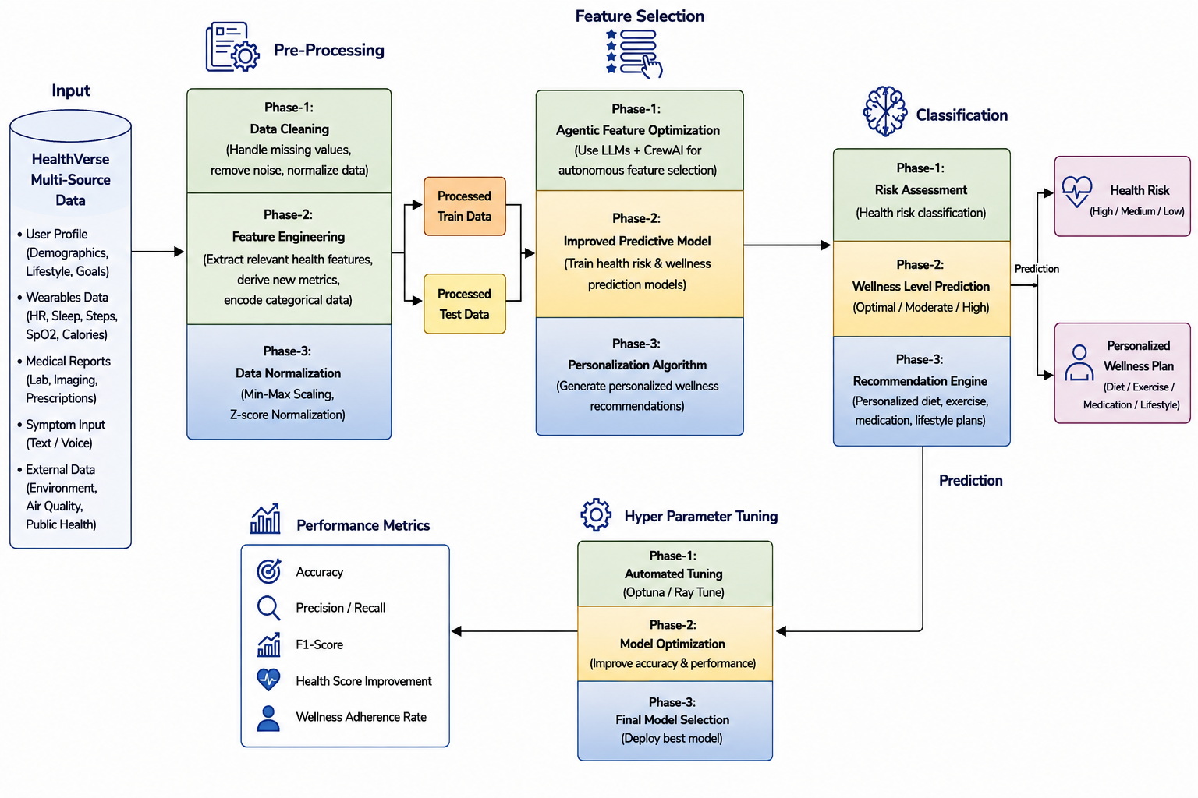
Project Architecture/Project Overview:

